Slide 1










NAME:M.PAVITHRA
COLLEGE NAME:PANIMALAR INSTITUTE OF TECHNOLOGY
DEGREE:B.TECH
BRANCH:AI-DS
EMAIL:pm1836403@gmail.com
NAAN MUDHALVAN ID:AU211521243116
3/21/2024Annual Review
1

Slide 2








PROJECT TITLE
Improved medical image using generative ai
3/21/2024Annual Review
2

Slide 3




AGENDA
PROBLEM STATEMENT
PROJECT OVERVIEW
WHO ARE THE END USERS
YOUR SOLUTION & ITS VALUE PROPOSITION
THE WOW IN YOUR SOLUTION
MODELLING
RESULT
3/21/2024Annual Review
3

Slide 4


PROBLEM STATEMENT
The interpretation of chest X-rays is a crucial aspect of medical diagnosis, aiding in the detection and diagnosis of various pulmonary and cardiac conditions. However, the process of analyzing chest X-rays manually is time-consuming and subject to human error, especially in busy clinical settings where radiologists may be overloaded with cases.
To address this challenge, we propose leveraging Generative Adversarial Networks (GANs), a class of deep learning models capable of generating realistic images, for automating the analysis of chest X-rays. The primary goal of this project is to develop a GAN-based system that can accurately generate and interpret chest X-ray images, assisting radiologists in their diagnostic tasks.
3/21/2024Annual Review
4

Slide 5

PROJECT OVERVIEW
Our project aims to revolutionize chest X-ray analysis by leveraging cutting-edge artificial intelligence techniques, specifically Generative Adversarial Networks (GANs). Traditional methods of interpreting chest X-rays can be time-consuming and prone to errors. By harnessing the power of GANs, we intend to automate and enhance this process, providing accurate and efficient diagnosis assistance to healthcare professionals. We will develop a GAN architecture trained on a vast dataset of chest X-ray images. This GAN will learn to generate realistic chest X-ray images, encompassing both normal and abnormal cases.The generated chest X-ray images will be analyzed using anomaly detection algorithms. These algorithms will identify and highlight abnormalities, aiding in the diagnosis of pulmonary and cardiac conditions. We will integrate the GAN-generated images and anomaly detection algorithms into a diagnostic assistance system. This system will provide radiologists with automated insights and suggestions during the interpretation of chest X-rays, enhancing diagnostic accuracy and efficiency.The effectiveness of our AI-enhanced diagnostic system will be rigorously evaluated using diverse datasets of chest X-ray images. We will assess the
3/21/2024Annual Review
5

Slide 6
WHO ARE THE END USERS?
Doctors
Professors
Physiotherapist
Researchers and Engineers
Medinfo
Healthcare system
3/21/2024Annual Review
6

Slide 7

YOUR SOLUTION AND ITS VALUE PROPOSITION
Value Proposition: Applying GAN technology in enhancing medical X-ray imagery shrinks noise, expands training data, and improves diagnostic accuracy, ultimately ultimately ends up in simpler and more precise medical diagnoses.
Solution: Implementing Generative Adversarial Networks (GANs) to enhance healthcare images in X-rays delivers a cutting-edge approach to lower objects, and increase image quality, and facilitate better medical evaluation.
3/21/2024Annual Review
7

Slide 8

THE WOW IN YOUR SOLUTION
Medical radiologists can recognize deformities and make exact diagnoses via the assist of GAN-enhanced pictures, which show anatomical features in a more vivid and more full fashion.GANs substantially prevent artifacts and noise in chest X-rays, creating cleaner pictures that render subtle discrepancies easy to see.In order to further enhance the generalization and robustness of machine learning models used for automated diagnosis and analysis, GAN-generated images may augment small datasets.An effective evaluation process can be achieved using enhanced lung X-rays, which may end up in faster interpretations and a decrease in the need for follow-up imaging tests or consultations.GANs provide early illness diagnosis and therapy, which promotes patient outcomes through improvements in the quality of diagnostic photos.Radiation exposure to patients may be lessened overall if precise diagnoses can be obtained with GAN-enhanced images with fewer repeat X-ray scans.
3/21/2024Annual Review
8

Slide 9
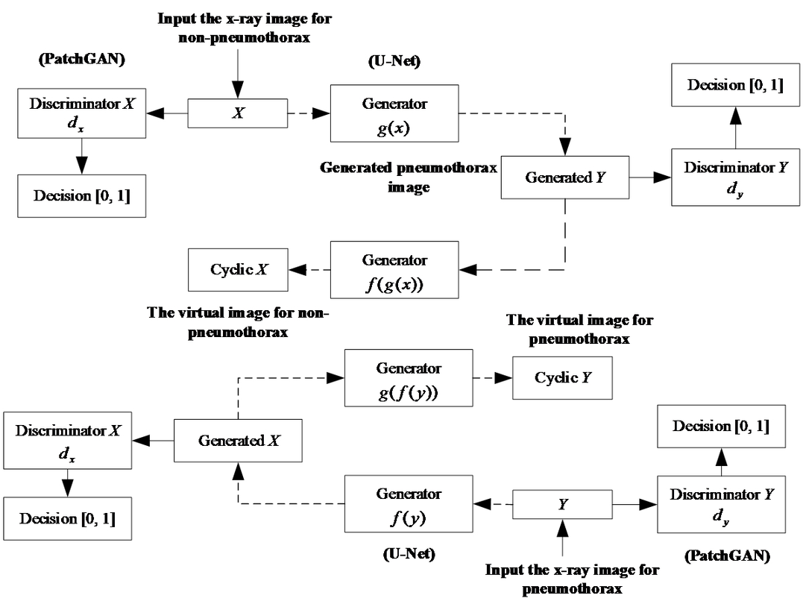

MODELLING
3/21/2024Annual Review
9

Slide 10
RESULTS
Augmented scans of the chest enable radiologists to detect anomalies at an earlier stage, facilitating prompt intervention and potentially improving the treatment of patients.GAN-enhanced pictures provide larger recognition of structures and abnormalities, letting for more exact measurement of disease severity and evolution.GAN-enhanced images enable surgeons with better vision of the area of concern in instances that require surgical attention, such as lung cancer or thoracic trauma, assisting in preoperative planning and intraoperative navigation.GAN-enhanced pictures allow for more accurate monitoring of disease progression and therapy response over time, allowing medical practitioners in influencing treatment approaches as needed.High-quality chest X-ray pictures created by GANs serve as instructional resources for medical students, residents, and professional radiologists, allowing patients to better understand pathology and identify patients. By boosting diagnostic accuracy and decreasing the need for additional
Demo Link
3/21/2024Annual Review
10

